Slide 1
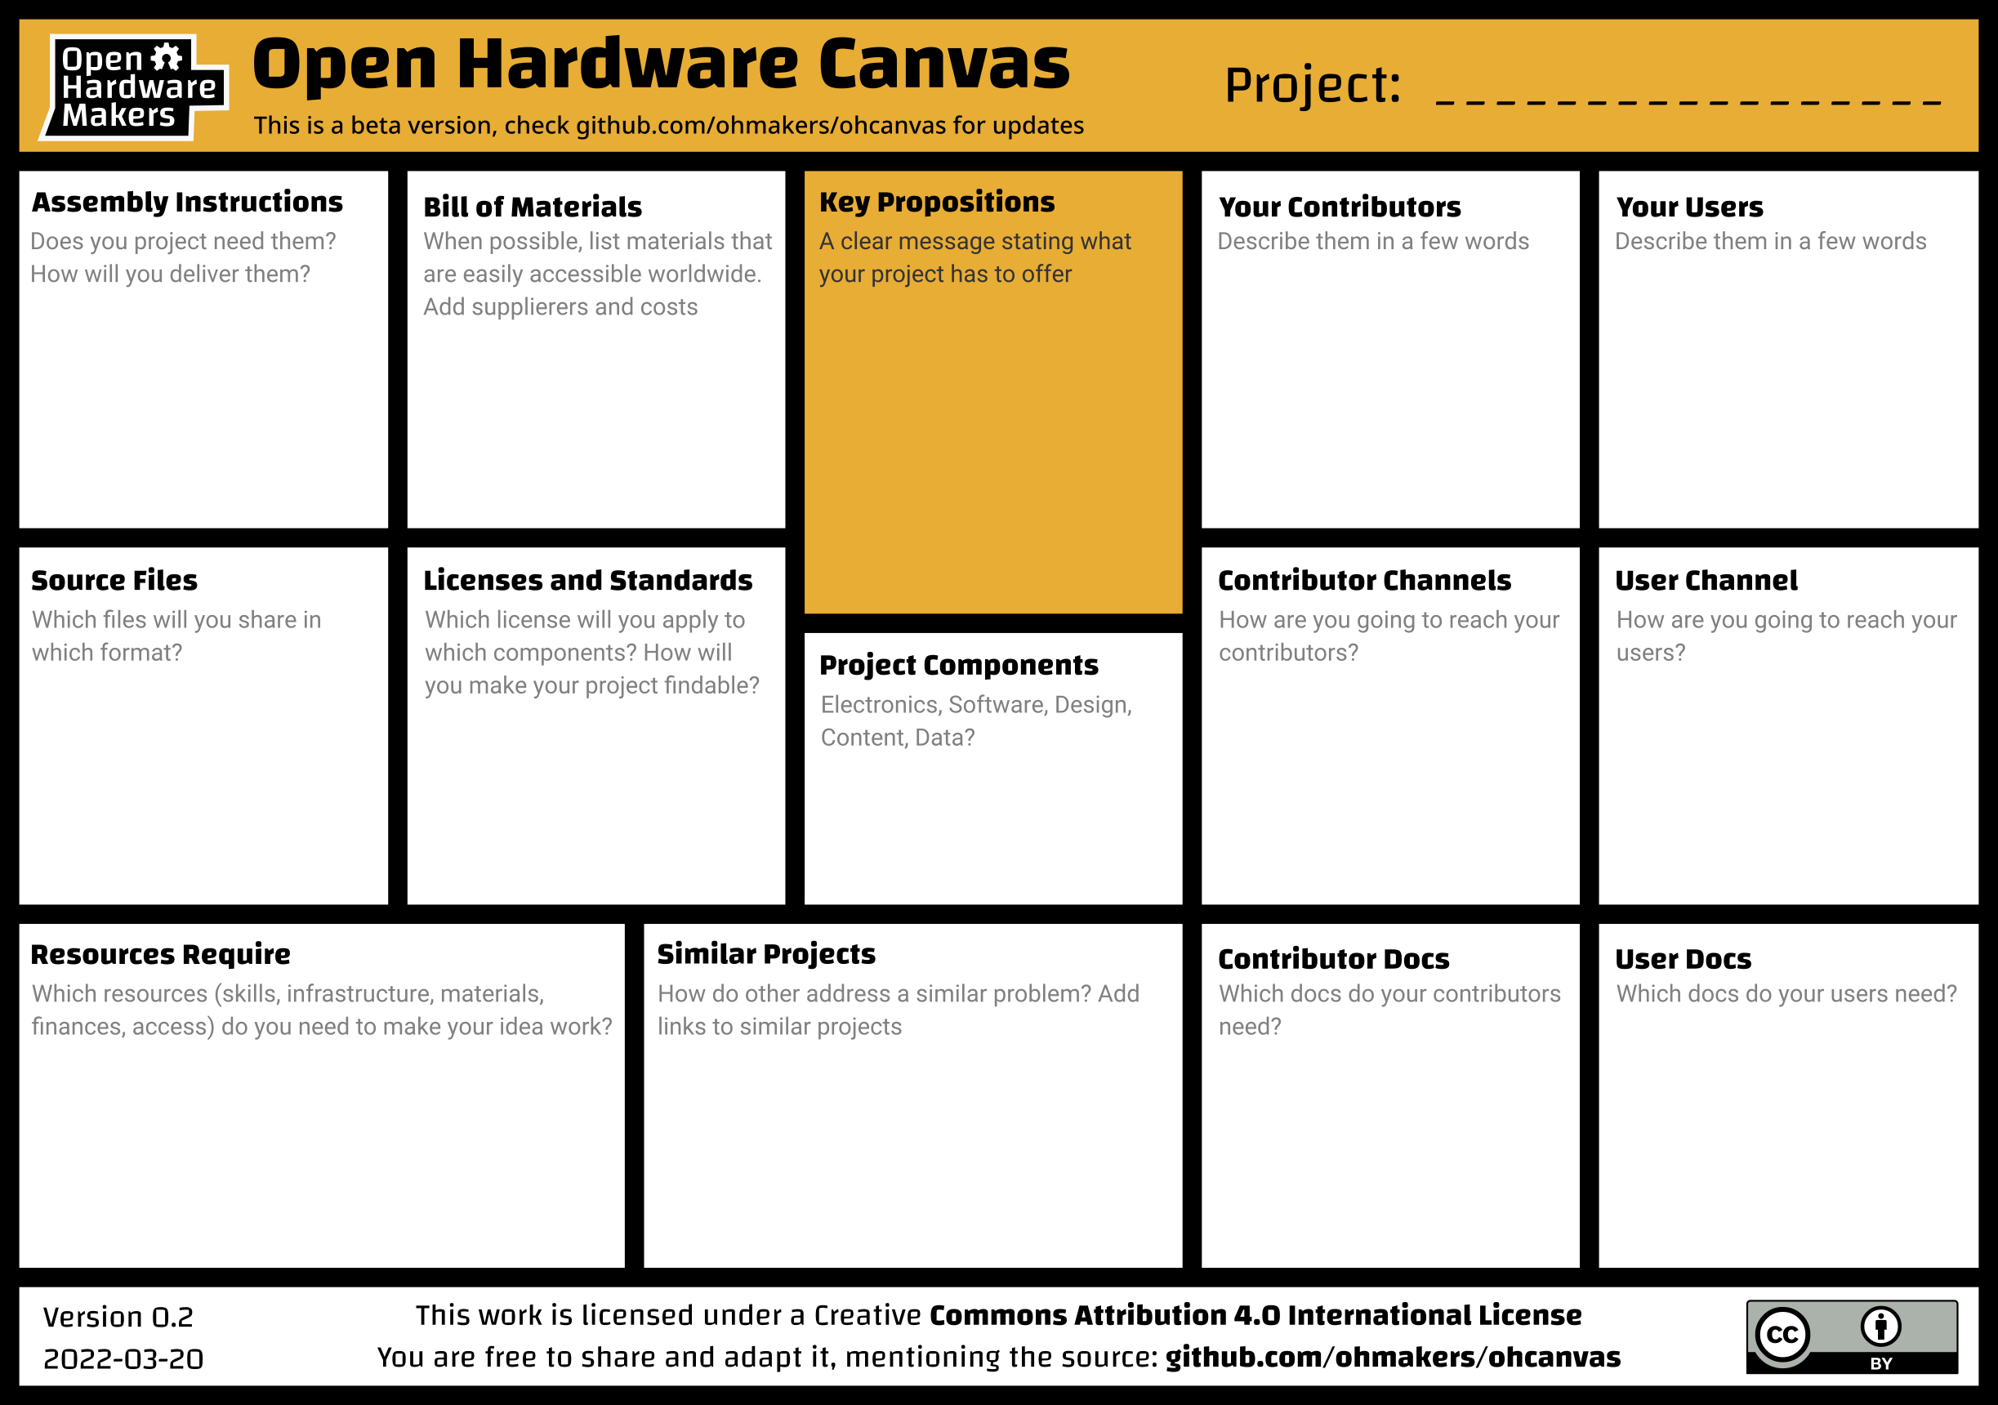

Slide 2
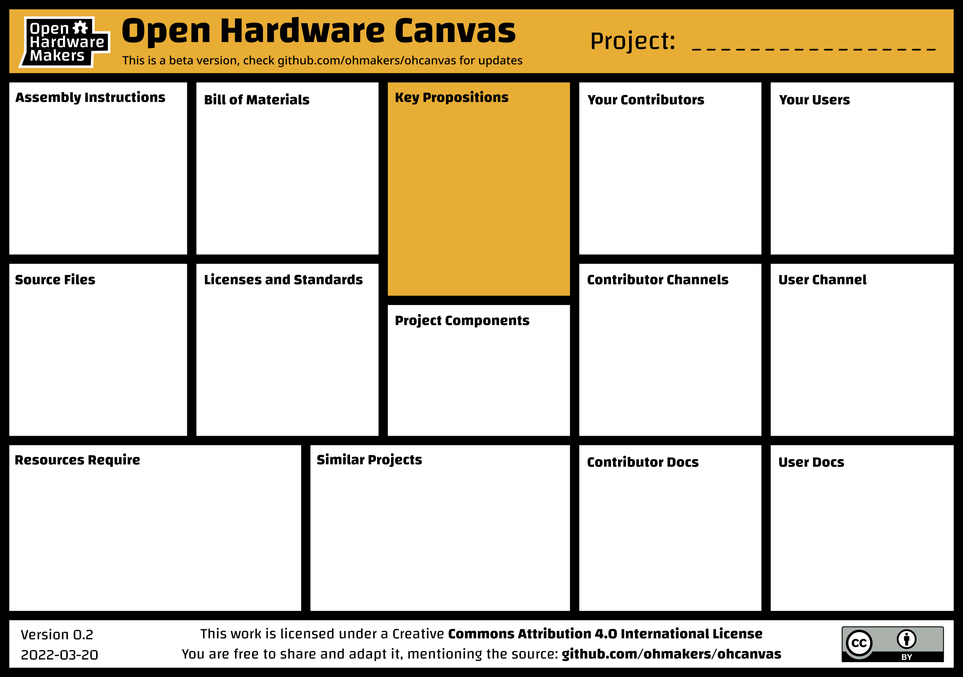
Felxi-TEER
Step-by-step instructions on github
Link to full BOM
This device takes trans-epthileal electrical resistance measurements (TEER) on cell cultures
Two primary forms
Fixed frequency
Impendence Spectroscopy
Longitudinal measurements
Wireless communication
Designed electronic circuit
Derived theory
Programmed
Designed case
Thiagarajah lab at BCH is only known user
Any lab that does experiments with cell barriers
Any lab that studies cell barriers
Shared on GitHub:
EasyEDA files for schematic and PCB design
STL files for 3D printed parts
Arduino Sketch file
Unknown
GitHub
email
GitHub
Electronics, 3D models, software, theory resources
Computer, soldering equipment for small surface mount components, 3D printer (FF)
EVOM add on https://www.ncbi.nlm.nih.gov/pmc/articles/PMC8000980/
Low cost TEER meter https://chemrxiv.org/engage/chemrxiv/article-details/60c746bdbb8c1aa1073da918
Simple meter https://www.jove.com/v/60087/a-simple-approach-to-perform-teer-measurements-using-self-made-volt
Schematic
Arduino Sketch
Model files for 3D model
Theory
Usage Manual
User assembly instructions

